Slide 1
Bootstrap

Slide 2
Introduction:
Bootstrap is a free front-end framework for faster and easier web development
Bootstrap includes HTML and CSS based design templates for forms, buttons, tables, navigation, modals, image and many other, as well as optional JavaScript plugins
Bootstrap also gives you the ability to easily create responsive designs

Slide 3
Advantages of Bootstrap:
Easy to use: Anybody with just basic knowledge of HTML and CSS can start using Bootstrap
Responsive features: Bootstrap's responsive CSS adjusts to phones, tablets, and desktops
Mobile-first approach: In Bootstrap, mobile-first styles are part of the core framework
Browser compatibility: Bootstrap 5 is compatible with all modern browsers (Chrome, Firefox, Edge, Safari, and Opera).

Slide 4
CDN (Content Delivery Network):
CSS :
<link href="https://cdn.jsdelivr.net/npm/bootstrap@5.2.3/dist/css/bootstrap.min.css" rel="stylesheet">
JavaScript :
<script src="https://cdn.jsdelivr.net/npm/bootstrap@5.2.3/dist/js/bootstrap.bundle.min.js"></script>

Slide 5
Java Script

Slide 6
Introduction:
JavaScript (js) is a light-weight object-oriented programming language.
which is used by several websites for scripting the webpages.
It is an interpreted, full-fledged programming language that enables dynamic interactivity on websites when applied to an HTML document.
It was introduced in the year 1995 for adding programs to the webpages in the Netscape Navigator browser.

Slide 7
Application of JavaScript:
JavaScript is used to create interactive websites.
It is mainly used for:
Client-side validation,
Dynamic drop-down menus,
Displaying date and time,
Displaying pop-up windows and dialog boxes (like an alert, confirm and prompt dialog boxes),
Displaying clocks etc.

Slide 8
Internal Js:
<script type="text/javascript">
document.write("JavaScript Example");
</script>
External Js:
messge.js
function msg(){
alert("Hello JavaScript");
}
Ex.html:
<script type="text/javascript“ src="message.js"></script>

Slide 9
Variable:
A JavaScript variable is simply a name of storage location.
There are two types of variables in JavaScript :
local variable and global variable.
Rules:
Name must start with a letter (a to z or A to Z), underscore( _ ), or dollar( $ ) sign.
After first letter we can use digits (0 to 9), for example value1.
JavaScript variables are case sensitive, for example x and X are different variables.

Slide 10
Local Variable Global Variable:
<script>
var value=50;
function a(){
alert(value);
}
function b(){
alert(value);
}
</script>
<script>
function demo() {
var z=50; document.write(z);
}
</script>

Slide 11
Data Types:
JavaScript provides different data types to hold different types of values.
There are two types of data types in JavaScript.
Primitive data type
Non-primitive (reference) data type
JavaScript is a dynamic type language, means you don't need to specify type of the variable because it is dynamically used by JavaScript engine.
You need to use var here to specify the data type.
It can hold any type of values such as numbers, strings etc.

Slide 12
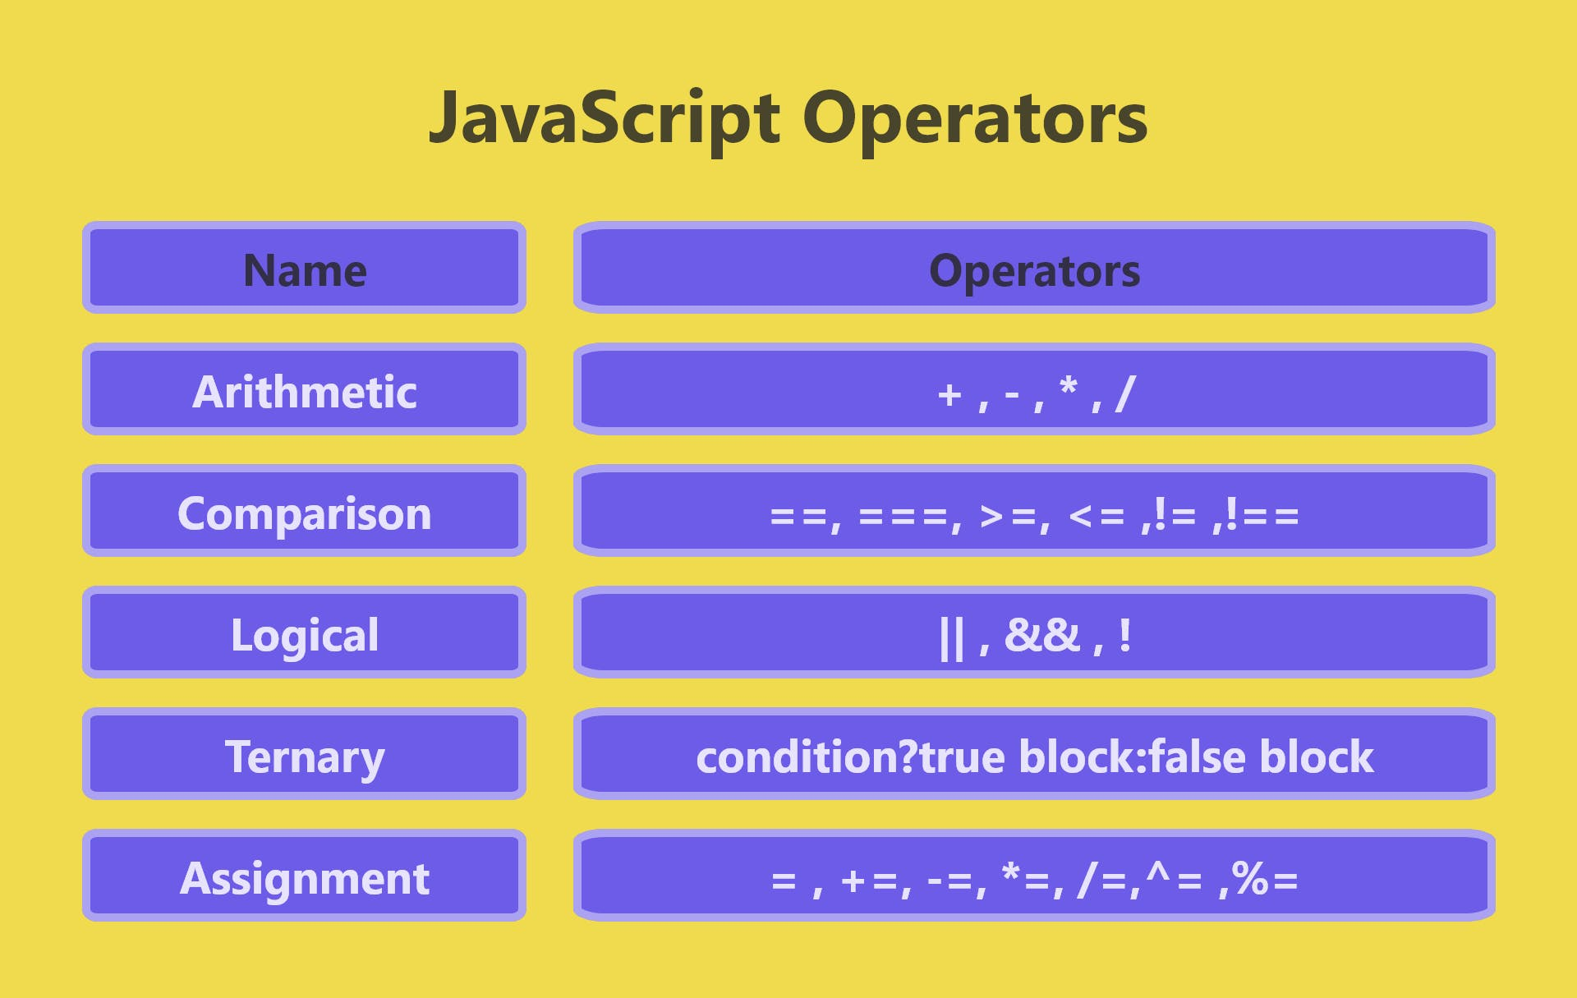
Operators:
,++,--
<,>,

Slide 13
Decision Contructs:
To change the flow of the program
Control Statements:
Conditional Branching: To check the condition right or wrong.
Conditional Looping: To repeat the process with conditions.
Syntax for Branching:
If:
if(Condition){
// Statement
}
If-else:
if(Condition){
//Statement
}
else{
// Statement
}

Slide 14
Else-if ladder:
Nested If:
if(Condition){
//Statement
if(condition)
{
//Statement
}
}
else{
// Statement
}
if(Condition1){
// Statement
}
else if(Condition1 2){
// Statement
}
else{
// Statement
}

Slide 15
Conditional Looping:
for(initializer; condition; increment/decrement)
{
//statement;
}
while(condition)
{
//statement;
increment;
}
do{
//statement;
increment;
}while(condition);

Slide 16
Functions:
JavaScript functions are used to perform operations.
We can call JavaScript function many times to reuse the code.
Advantage of JavaScript function
Code reusability: We can call a function several times so it save coding.
Less coding: It makes our program compact.
We don’t need to write many lines of code each time to perform a common task.

Slide 17
Types:
With argument with Return
Without argument with Return
With argument without Return
Without Argument without Return
Syntax:
function functionName(arguments)
{
//code to be executed
}

Slide 18
Exapmle:
<script>
function msg(name)
{
alert("hello! “ + name);
}
</script>
<input type="button" onclick="msg(“Zoro”)"
value="call function"/>

Slide 19
Event Handling:
Onclick Event:
<h1 id="rose"></h1>
<button onclick="Click()">Submit</button>
<script>
var count=0;
function Click(){
count=count+1;
document.getElementById("rose").innerHTML=count;
}
</script>

Slide 20
On-change Event:
<select id=“R">
<option value="1">Tae</option>
<option value="2">Kookie</option>
<option value="3">Jimin</option>
</select>
<script>
function Demo(){
alert("Value select");
}
document.getElementById(“R").onchange=Demo;
</script>

Slide 21
Mouse Over Event:
<h1 onmouseover="Demo()">Hello Everyone</h1>
<script>
function Demo() {
document.write("My action event");
}
</script>

Slide 22
Confirmation Action:
<form action="">
<input type="button" onclick="Demo()" value="want to confirm? ">
</form>
<h1 id="rezult"></h1>
<script>
function Demo() {
var z=confirm("Are you ready to confirm?");
if(z==true){
document.getElementById("rezult").innerHTML="Confirmed";
}
else{
document.getElementById("rezult").innerHTML="Cancelled";
}
}
</script>

Slide 23
JavaScript Objects:
JavaScript is an object-based language.
Everything is an object in JavaScript.
JavaScript is template based not class based.
Here, we don't create class to get the object. But, we direct create objects.
Exapmle:
var emp=new Array("Jai","Vijay","Smith");
for (i=0;i<emp.length;i++){
document.write(emp[i] + "<br>");
}

Slide 24
Math Object:
The JavaScript math object provides several constants and methods to perform mathematical operation. Unlike date object, it doesn't have constructors.
abs() → It returns the absolute value of the given number.
exp() → It returns the exponential form of the given number.
floor() → It returns largest integer value, lower than or equal to the given number.
pow() → It returns value of base to the power of exponent.
random() → It returns random number between 0 and 1.
sqrt() → It returns the square root of the given number

Slide 25
Example:
<body>
<h1>Square Root of 17 is: <span id="p1"></span>
Random Number is: <span id="p2"></span>
3 to the power of 4 is: <span id="p3"></span>
Floor of 4.6 is: <span id="p4"></span> </h1>
<script>
document.getElementById('p1').innerHTML=Math.sqrt(17);
document.getElementById('p3').innerHTML=Math.pow(3,4);
document.getElementById('p2').innerHTML=Math.random();
document.getElementById('p4').innerHTML=Math.floor(4.6);
</script>
</body>

Slide 26
JS Time formate:
The JavaScript date object can be used to get year, month and day.
You can display a timer on the webpage by the help of JavaScript date object.
You can use different Date constructors to create date object.
It provides methods to get and set day, month, year, hour, minute and seconds.
You can use 3 variant of Date constructor to create date object.
Date()
Date(milliseconds)
Date(year, month, day, hours, minutes, seconds, milliseconds)

Slide 29
jQuery

Slide 30
Introduction:
jQuery was first released in January 2006 by John Resig at BarCamp NYC.
It is currently headed by Timmy Wilson and maintained by a team of developers.
Nowadays, jQuery is widely used technology most of the websites are using jQuery.
jQuery is a small and lightweight JavaScript library.
jQuery means "write less do more".
jQuery is developed by Google.
To create the first jQuery example, you need to use JavaScript file for jQuery.

Slide 31
Example:
Link:
<script type="text/javascript" src="http://ajax.googleapis.com/ajax/libs/jquery/2.1.3/jquery.min.js">
</script>
jQuery:
<script type="text/javascript" language="javascript">
$(document).ready(function()
{
$("p").css("background-color", "cyan");
});
</script>

Slide 32
Jquery Effects
jQuery provides a trivially simple interface for doing various kind of amazing effects like show, hide, fade-in, fade-out, slide-up, slide-down, toggle etc.
jQuery methods allow us to quickly apply commonly used effects with a minimum configuration.
Example:
Toggle Effect:
$(document).ready(function() {
$("#button").click(function(){
$("#box").toggle(1000);
});
});

Slide 33
Hide and Show :
<script>
$(document).ready(function() {
$("#show").click(function(){
$("#box").show(2000);
});
$("#hide").click(function(){
$("#box").hide(1000);
});
});
</script>
<div id="box">This is Box</div>
<button id="button">Toggle Box</button>

Slide 34
Fade In and Fade Out:
<script>
$(document).ready(function() {
$("#show").click(function(){
$("#box").fadeIn(1000);
});
$("#hide").click(function(){
$("#box").fadeOut(1000);
});
});
</script>

Slide 35
Slide Up & Slide Down:
<script>
$(document).ready(function() {
$("#show").click(function(){
$("#box").slideUp(1000);
});
$("#hide").click(function(){
$("#box").slideUp(1000);
});
});
</script>

Slide 36
Toggles:
<script> $(document).ready(function()
{
$("#button").click(function()
{
$("#box").fadeToggle(1000);
// $("#box").slideToggle(1000);
});
});
</script>

Slide 37
Animation:
The jQuery animate() method is used to create custom animations by changing the CSS numerical properties of a DOM element, for example, width, height, margin, padding, opacity, top, left, etc.
jQuery animate() method can not be used to animate non-numeric properties such as color or background-color etc.
Though you can use jQuery plugin jQuery.Color to animate such properties.
Example:
$("div").animate({left: '0px',width:'180px’,
height:'100px', opacity:1.0});

Slide 38
Example:
<script>
$(document).ready(function() {
$("#right").click(function(){
$("div").animate({left: '250px'});
});
$("#left").click(function(){
$("div").animate({left: '0px'});
});
});
</script>
<div id="box">This is Box</div>
<button id="right">Right Move</button>
<button id="left">Left Move</button>

Slide 39
Example:
<script>
$(document).ready(function() {
$("button").click(function(){
$("div").animate({left: '250px'});
$("div").animate({top: '100px'});
$("div").animate({left: '0px'});
$("div").animate({top: '0px'});
});
});
</script>
<div id="box">This is Box</div>
<button>Start Animation</button>

Slide 40
JSON:
JSON Stands for JavaScript Object Notation.
It is an open standard format, which is text-based, designed explicitly for human-readable data interchange.
It is a language-independent data format.
It supports almost every kind of language, framework, and library.
JSON is an open standard for exchanging data on the web.
It supports data structures like objects and arrays.
So, it is easy to write and read data from JSON.

Slide 41
Example:
JSON Object:
{"name" : “Tae", "employeeid" : 001, "present" : false}
JSON Array:
[{
"PizzaName" : "Country Feast",
"Base" : "Cheese burst",
"Toppings" : ["Black Olives", "Extra cheese", "Sausages", "Cherry tomatoes"],
"Spicy" : "yes",
"Veg" : "yes"
}]

